Slide 1
How much should I really care about AI right now… and where’s the real ROI in my portfolio? How PE leaders can cut through the noise and act on AI where it matters most
May 2025

Slide 2
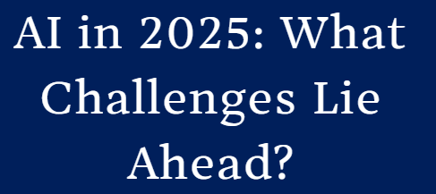
Cutting through the ‘AI noise’ and knowing how fast to move can be difficult
What is the right approach for a given PortCo?
IBM CEO Says AI Has Replaced Hundreds of Workers but Created New Programming, Sales Jobs
The tech company promises higher total employment as it reinvests resources toward roles like software development
All-In?
Fast Follower?
Late Adopter?
Changing the Game: How AI Is Poised to Transform Banking, Capital Markets
Beyond accelerating today’s business initiatives, leading organizations are planning tomorrow’s strategies around new AI
Wharton’s Lynn Wu predicts that the runway growth of artificial intelligence will hit some roadblocks in 2025, including costs and data limitation.

Slide 3
If your business operates like this… AI can deliver high ROI
Portfolio view
People & Operations
Sales
Admin Workforces: Large teams handling clerical or knowledge-based tasks (insurance claims, healthcare admin, HR outsourcing, legal ops)
Repetitive Workflows: Significant time spent on the same tasks (customer onboarding teams in SaaS, RFP response teams, financial reconciliation staff)
Customer Support Volumes: High volume of orders, returns, and service complaints (e-commerce, warranties, contact centers)
Demand Volatility: Hard to predict cycles or spikes (retail, event ticketing, staffing, procurement)
Dynamic Pricing Needs: Prices shift by time, market, or channel (hotels, flights, rideshare, marketplaces, auto dealers)
Retention Risks: Customers churn easily or have low switching costs (telecom, consumer banking, gyms, streaming services)
Product
Data & Analytics
Fast-Changing Needs: Regular updates to meet evolving customer expectations (consumer electronics, wellness, gaming, fintech)
Personalized Experiences: Tailored demos, content, or interfaces (travel planning, streaming services, software demos)
Rapid Content Generation & Testing: Constant need for new copy, visuals, or UX iterations (media, ecommerce, education, apps)
Disconnected Data: Data stuck in silos or systems that don’t communicate (retail, multi-site roll-ups, food & beverage, franchisee-driven businesses)
Real-Time Forecasting: Complex, time-sensitive demand or performance models (CPG, retail, ad spend, demand planning)
Untapped Data Assets: Large volumes of unstructured or fast-moving data (call transcripts, sensor data, support chats, medical images)
Finance & Risk
IT & Infrastructure
Manual Finance Processes: Time-intensive close, audit, or budgeting (finance teams, large non-profits, healthcare reimbursement)
Fraud & Risk Detection: Exposure to fraud, default, or credit risk (banking, insurance, fintech, gaming)
Automated Decisioning Rules: Rules-based underwriting or financial approvals (lending, credit cards, procurement)
System Monitoring & Maintenance: Large, complex environments needing uptime assurance (cloud platforms, gaming, telcos, SaaS)
Security & Anomaly Detection: Need for real-time threat awareness and log analysis (financial services, defense tech, healthcare IT)
Hybrid Infrastructure: Managing both cloud and on-prem environments (large enterprises, heavily regulated industries)

Slide 4
We have executed AI-enabled improvements across multiple areas
PortCo view
Areas | AI Use Cases | Client Results
Markets | Analyze customer feedback to uncover unmet needs or churn drivers Competitive intelligence (pricing, product, customers); value proposition positioning | Recovered $100M+ within 3 months by resolving false defect claims through AI sentiment analysis
Products / Services | Boost marketing performance using image recognition Optimize product mix and media spend to drive sales and sell-through Recommend product attribute combos to lift margins Personalization; “segments of 1” | Boosted ad awareness by 50% using AI-driven, real-time video tagging Cut $60M in media spend from AI-optimized product/channel mix
M&A / Joint Venture Operations | Identify potential acquisition candidates Evaluate acquisition targets beyond traditional | Cut human research time to identify potential candidates by 80% Boosted research breadth by 10x using public data and internal ROI filters
Supply Chain Operations | Analyze demand patterns and optimize supply chain Generate IoT based, real-time updates from manufacturing/logistics Improve forecast accuracy Optimization of digital factory twins | Reduced inventory costs by 20% and logistics costs by 15% via AI demand planning Improved sales forecast accuracy by 15%
Gross Margin Improvement | Adjust pricing based on demand shifts, margin goals, or competitor moves Catch fraud patterns in real time Increase ROI by reducing default/bad-deal exposure with better risk modeling | Drove 12% revenue increase and 15% margin lift from AI-based dynamic pricing Cut fraud by 50% and chargebacks by 40% Improved high-risk ID by 30% Cut defaults by 25% with AI modeling
Overhead | Automate routine, high volume transactional tasks Reduce support costs by offloading repetitive inquiries | Saved $30M by automating finance ops with AI bots Lowered support costs by 30% and improved response time by 20%
Program Management / Execution | Track program milestones and auto-flag slippage Draft consistent updates and reduce time spent reporting | Reduced strategic planning time by 75% Significantly reduced errors and effort spent on first draft of proposal
1
2
3
4
5
6
7

Slide 5
Our rapid diagnostics identify the most impactful AI opportunities
Diagnostic Process
Diagnostic Output
1) Evaluation of current AI Usage: Including AI usage across the competitive landscape, and gaps in AI capabilities
2) AI adoption readiness assessment: Assessment of data maturity and actionable roadmap to enable scalable AI deployment
3) Prioritized near-term opportunities: High-impact, repetitive workflows ripe for automation (cost reduction, product leadership, and customer experience)
4) Implementation roadmap: Including alignment with IT infrastructure, data clean-up, design of experiments, and validation/scale up approach
5) Estimated ROI: Cost/revenue benefit, implementation cost
6) Change management assessment: Insight into change-readiness to tailor AI adoption strategies for stakeholder alignment and engagement
AI expert review of PortCo AI usage and alignment with business goals
Top-level process mapping and time allocation analysis to surface automation and AI opportunities
Evaluation of value-add time, frequency, and repetitiveness
Evaluation of data infrastructure/organization/cleanliness (i.e., readiness for AI adoption)
Identification of Quick-win opportunities for AI implementation
Areas that can quickly adopt AI tools
Review of culture/openness to change
Resources: HPA Subject Matter Expert & “Teamlet” (1+1)
Timeframe: 4-6 weeks
Participation: 2-4 hours/week, including 1-2 workshops from/with:
Functional leads for areas with high potential
IT/Tech leadership
Potential sponsor and/or execution lead (for capability transfer)

Slide 6
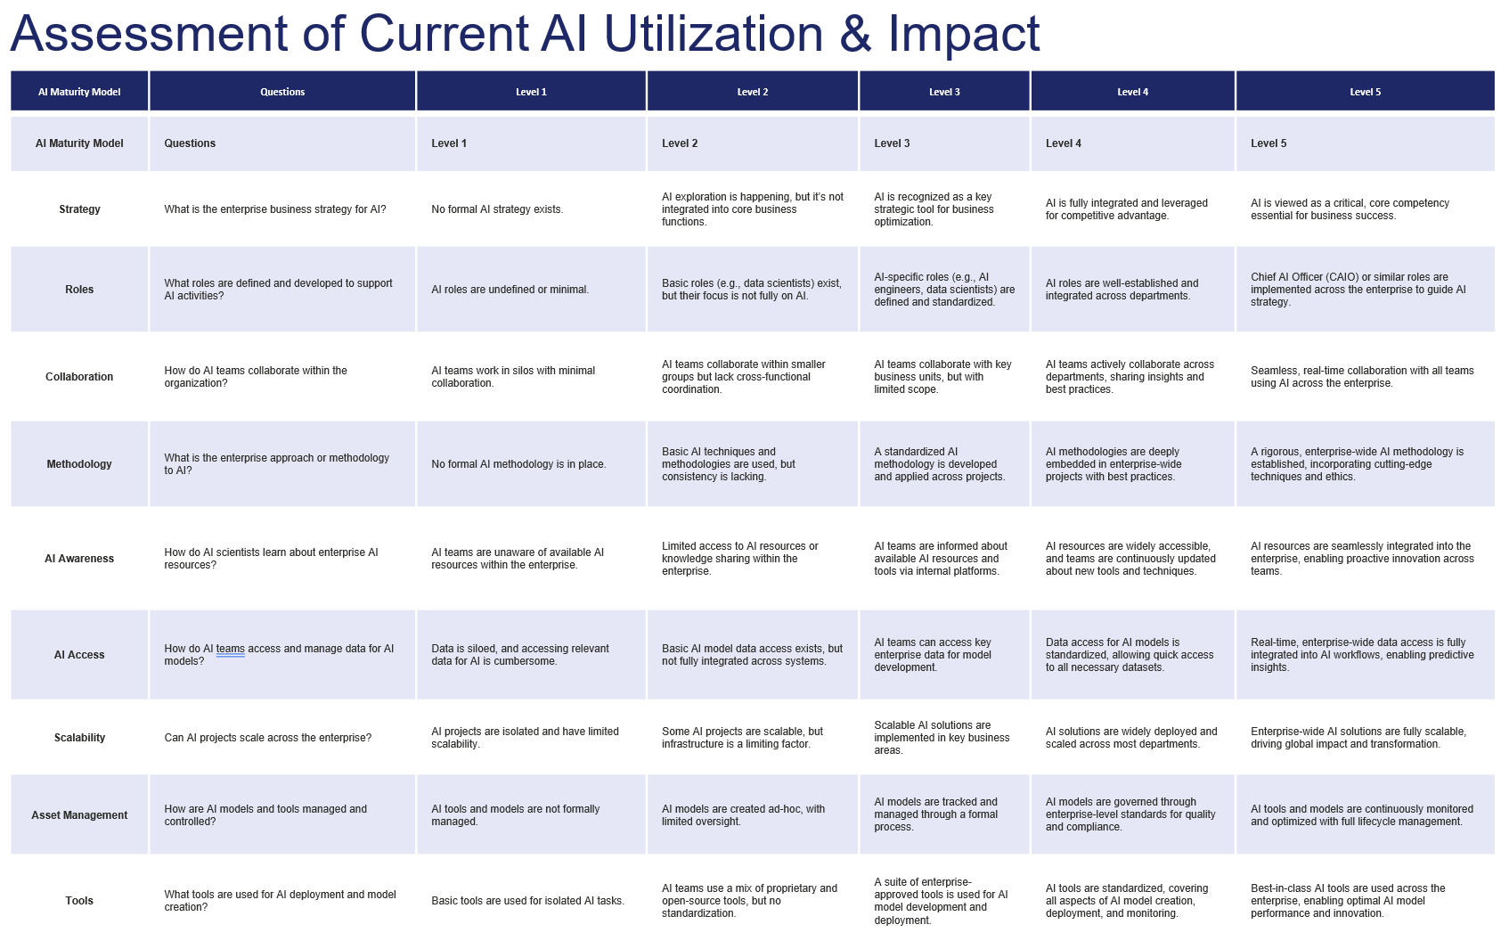
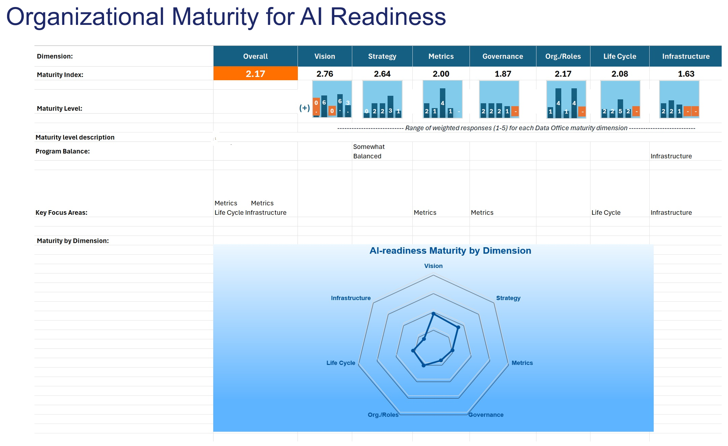
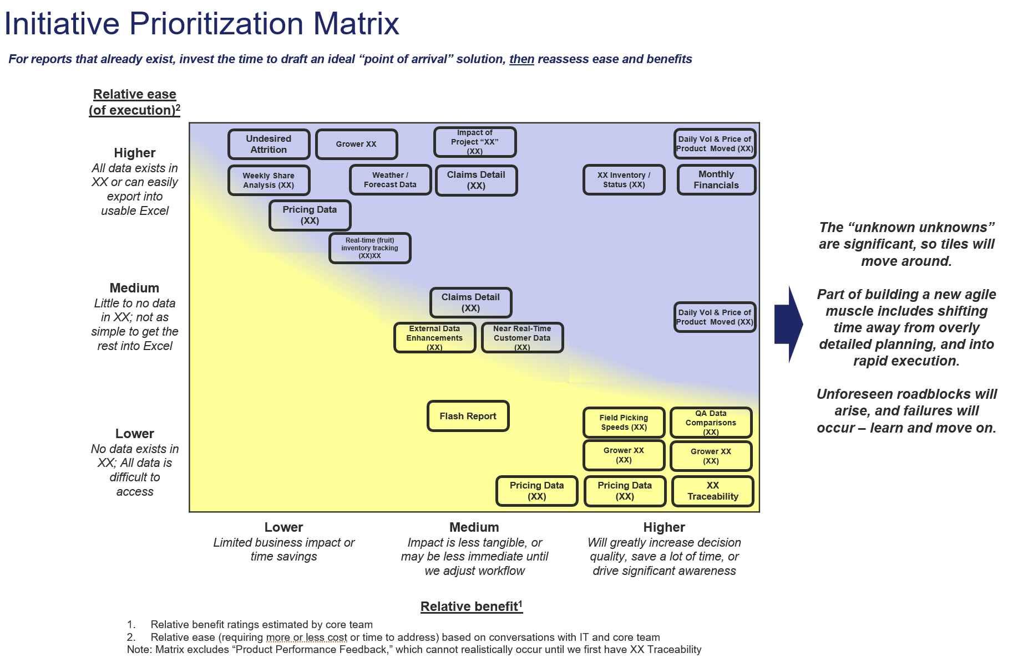
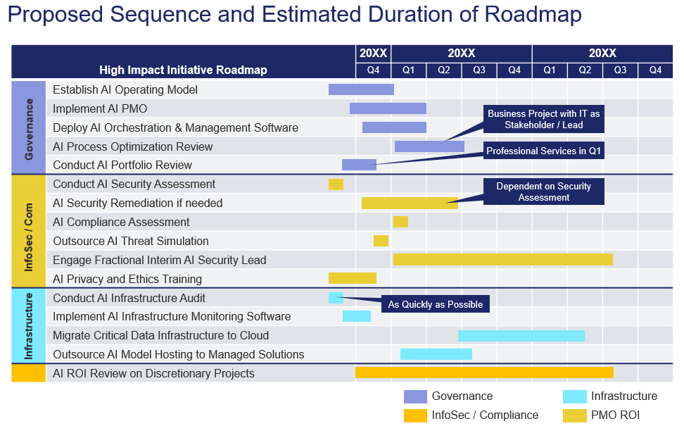
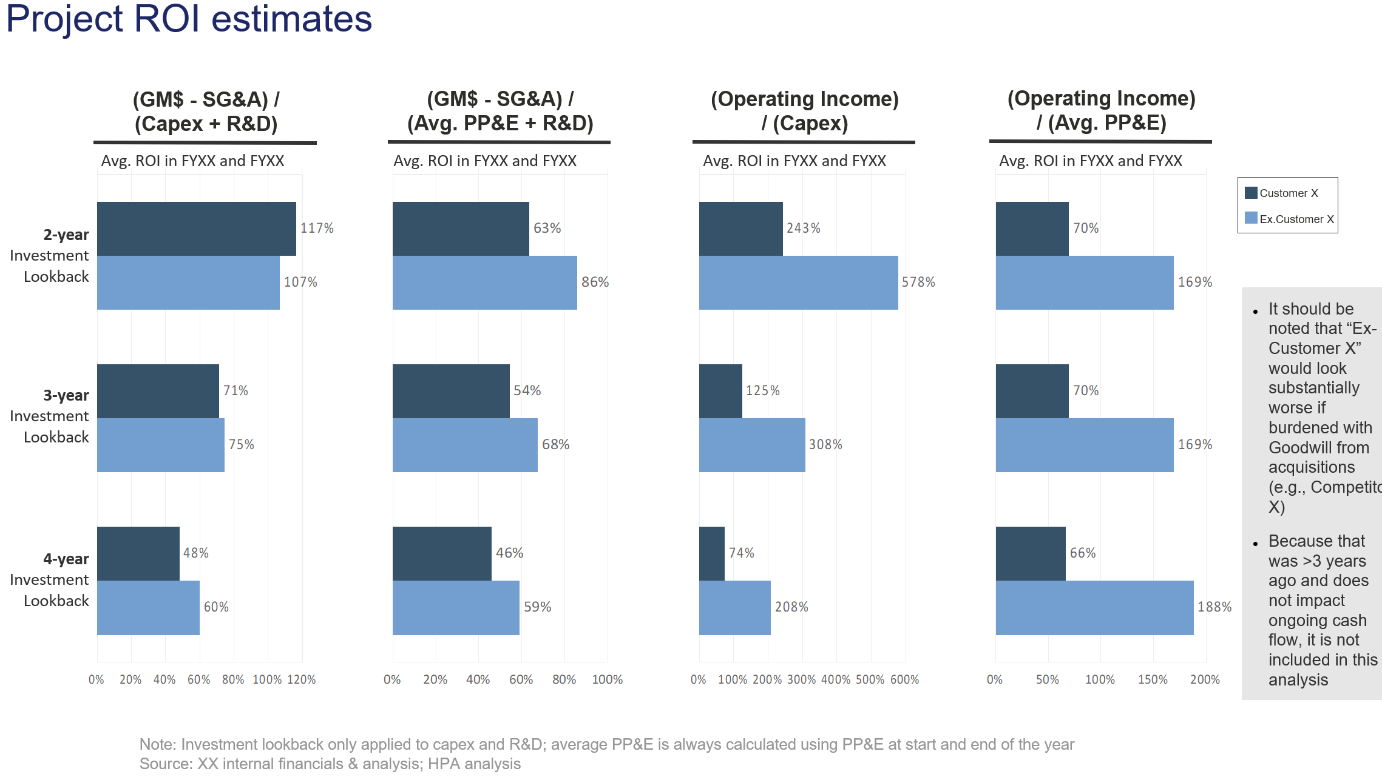
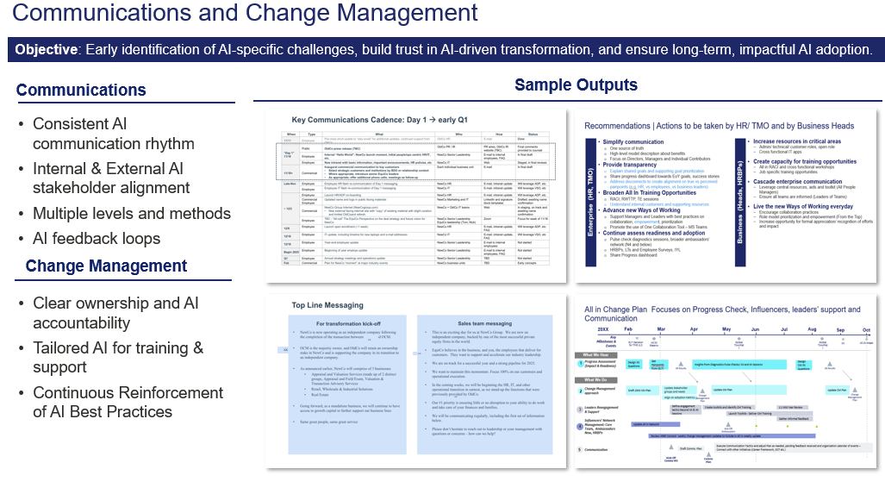
Example AI Diagnostic Output
ILLUSTRATIVE
Evaluation of Current AI Usage
AI Adoption Readiness Assessment
Prioritized Near-Term Opportunities
Implementation Roadmap
Estimated ROI
Change Management Assessment

Slide 7
Data Analytics & AI Practice Leadership
 | Leadership | Experience
 |  | Delivered $100M+ in savings at Amazon through AI / ML-driven CX optimization and fulfillment network analytics Built AI-powered Starbucks Placemat for C-suite decision-making; launched SMART KPIs and Voice of the Customer AI to drive enterprise impact Stood up Saatchi & Saatchi’s ‘Data-At-The-Center’ competency and led a data science team delivering MTA, MMM, and predictive analytics across the marketing funnel
 |  | Led 500+ global analytics team at Target, overseeing predictive modeling, optimization, big data, and BI across all enterprise functions Built Microsoft’s first ROI-driven marketing analytics system, transforming campaign performance measurement Scaled BCG X’s Software and Retail AI practices, advising clients on ML, data engineering, and analytics transformation
 |  | Built Red Bull’s real-time analytics platform processing 2B+ events; piloted computer vision for ad product innovation and data enrichment Launched Arterys’ AI marketplace and CRO business, securing $28M Series C and scaling strategic partnerships in medical imaging Led product and engineering at Iterative Scopes, building a cloud platform for AI-powered annotation of clinical video data
 |  | Led AI-driven workforce optimization for Fortune 50 insurer, identifying $1B+ in cost savings across 40K employees by mapping workflows and automation opportunities Built and deployed a RAG-based AI solution for contract analysis, boosting underwriting speed 10x and generating $250M in business value Scaled ML-powered platform at a major US brokerage, enabling sales automation, scenario planning, and direct indexing—tripling AUM in one year
Das Dasgupta – Senior Advisor
Former McKinsey AP who held senior roles including Chief Data & Analytics Officer at Starbucks, Chief Data & AI Officer at Saatchi & Saatchi, Global SVP of Data Science and Digital Transformation at Viacom, and Director of Customer Experience at Amazon
Ujjwal Sinha – Senior Advisor
Former McKinsey EM and Partner at BCG X with experience across analytics and AI; held senior roles including VP of Enterprise BI & Analytics at Target, Director of Strategy and Product at Microsoft, and VP of Strategic Services Operations at Salesforce
Christian Ulstrup – Project Leader
AI product leader with over a decade of experience helping 100+ organizations adopt and scale AI technologies. Former Senior Product Manager at Red Bull Media House, Head of Product and Tech at Iterative Scopes, MIT AI Conference Co-Chair, and Senior Product Manager at Arterys
Mike Mayes – Project Leader
Former Partner at BCG Digital Ventures & AI with experience leading AI / ML transformation across industries. Previously Chief Product Officer at WorkMarket (acquired by ADP), and product leader at GLG and Capital One

