Slide 1
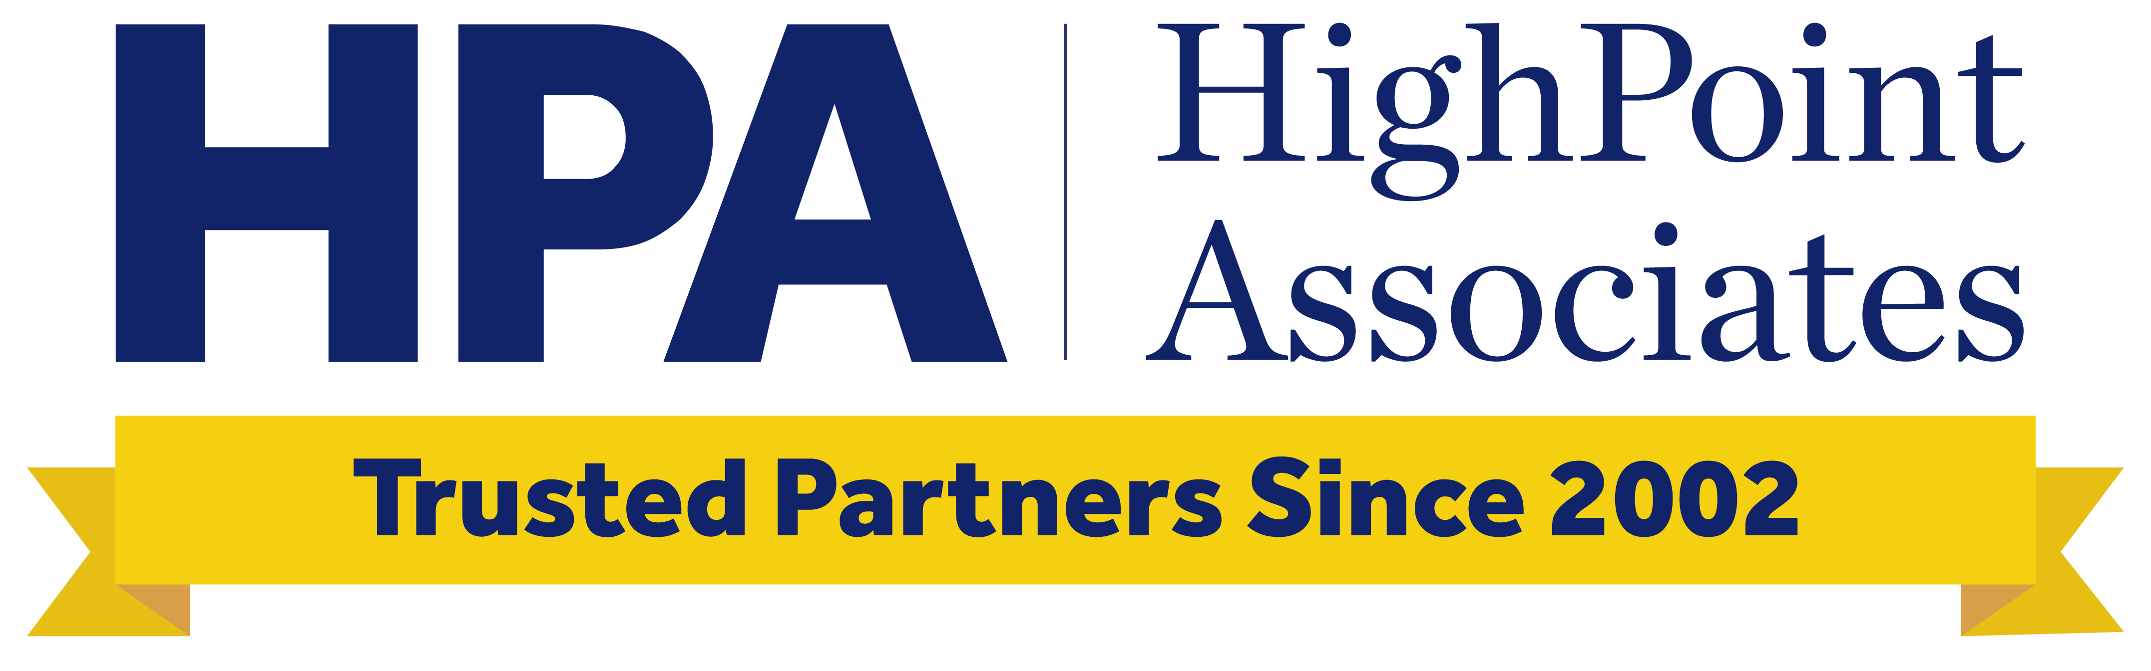
Integration Practice Overview
November 2025

Slide 2





Within the M&A lifecycle, our Integration practice focuses on pre-close and post-close activities
M&A Lifecycle
Sourcing | Diligence | IMO Planning (Pre-Close) | PMI Execution (Post-Close)
Identify and shape acquisition opportunities that align with strategic priorities and value creation thesis, building a disciplined and prioritized pipeline of actionable targets | Asses target performance, capabilities, and risks to validate the deal thesis, quantify potential value, and produce concrete recommendations for integration and negotiation | Design the integration strategy, governance, and readiness plan to ensure operational, cultural, and leadership alignment before close, enabling a seamless Day-1 and synergy capture | Execute the integration roadmap to deliver synergies, stabilize operations, and embed a unified operating model and culture that sustain long-term value creation
HPA’s Focus

Slide 3

Our Integration practice drives significantly more value than those at other firms
Robust experience with integration, not just consulting
Strategic integration mindset accelerates and sustains value
Working with you to secure stakeholder engagement
Proven track record in cultural/organizational alignment
Integrity and transparency for sustainable impact
Brings consulting-trained and proven integration leaders with within-firm execution experience
Drives rapid risk recognition and opportunity capture given integration and M&A experience
Embeds with management to align, execute, and deliver measurable impact
Accelerates impact and realize synergies quickly while securing long-term value
Reveals interdependencies, downstream effects, and growth levers
Drives a results-oriented business transformation approach
Engages executives and leaders to align on priorities and consider trade-offs
Collaborates side-by-side to build trust, mobilize teams, and preempt friction
Complements internal team’s skills and leverage existing resources
Provides expertise in enterprise-wide organizational change and integration governance
Addresses cultural implications to sustain engagement, retention, and adoption
Has clear view of structures, roles, and decision rights across both legacy organizations
Has daily touchpoints with senior team
Emphasizes that right ethical decisions always equal right business decisions
Leads with empathy and transparency
Establishes a clear path to transfer know-how and avoid consultant lock-in
Traditional Consulting Firms
Bring experience concentrated at Partner/SME level
Execute generic playbooks with junior team
Emphasize process and milestone tracking
Focus solely on long-term business value
Have limited ability to marshal support across levels
Impose decisions instead of co-owning them
Provide primarily a project management skillset
Have limited ability to shape culture or alignment
Have incentives to extend projects indefinitely
Have model of ‘Senior team sells, junior team shows up for work’

Slide 4
Common integration pitfalls… … and how HPA overcomes them
Strategic Misalignment | Integration not tied to the deal thesis: The IMO executes a generic playbook instead of one anchored to the investment rationale and value drivers
 | Activity over impact: Teams measure progress by milestones completed, not value captured
 | Unclear success definition: Leadership lacks transparent linkage between integration workstreams and the deal’s P&L or synergy targets
Organizational and Cultural Breakdown | Misaligned incentives and KPIs: Legacy leaders are rewarded for protecting their silo, not for integration success
 | Culture and communication gaps: Integration planning overlooks culture diagnostics, leading to distrust and resistance
Operational & Executional Friction | Overengineering and slow execution: Teams over-plan instead of prioritizing high-value Day-1 and Day-100 actions
 | Systems and process bottlenecks: Technology, finance, and/or HR integration drags delay synergy capture
 | Decision gridlock: Ambiguous governance creates confusion on who decides what and when
We design the integration roadmap directly from the deal thesis, linking each initiative to financial and strategic outcomes
We embed measurable synergy metrics, ownership, and reporting cadence into every workstream
We implement governance that connects integration activities to realized business impact – visible to both IMO and executive sponsors
We redesign KPIs and performance frameworks, so leaders share ownership of post-close results
Our operators have lived integrations; they model trust-building and consistent messaging across both organizations
We design pragmatic integration sequences that minimize customer and employee disruption
Our experts coordinate cross-functional dependencies to keep operations stable through transition
Our IMO governance model defines clear decision rights and escalation paths to maintain momentum

Slide 5






Recent integration projects reflect our flexible staffing model
Full Team
Teamlet
Individual
Client
PE firm with upper mid-market focus required a plan to evaluate two simultaneous acquisitions and identify growth opportunities
Healthcare services leader preparing a major acquisition needed support to establish an IMO for pre-merger planning and PMI execution
Leading industrial equipment manufacturer sought support to lead integration planning and execution for a complex international acquisition
Team Experience
Pre-Merger Planning Team
8 consultants
PMI Support & Execution Team
2 consultants
Integration Lead
1 consultant
Former McKinsey & Bain
PMI
Former McKinsey
IMO
Former McKinsey & CFO
PMI
M&A
Market Assessment
Pre-Merger Planning
Post-Close Execution
Change Management
Global M&A
Project Overview
Market Analysis: Assessed total addressable market size, competitive landscape, and growth trajectory across priority geographies
Integration Hypotheses: Assessed feasibility of merging the two companies’ platforms and operating models
Execution Framework: Defined the high-level organizational design and requirements to realize targeted synergies
IMO Setup: Partnered with ELT to stand up the IMO and roll out standardized planning / reporting across 5 areas and 8+ functions
PMO Leadership: Led pre-merger and early PMI cadence, addressing resourcing gaps and resolving key functional issues
Execution Outcomes: Merger completed ahead of schedule with a fully trained IMO in place to manage remaining integration
Integration Planning: Developed a comprehensive playbook and roadmap detailing timing, savings, and ownership to guide execution
Execution Leadership: Led initial implementation, established tracking mechanisms, and drove early progress across workstreams
Capability Transfer: Identified and trained internal leaders, enabling full client ownership and seamless handoff within four months

Slide 6
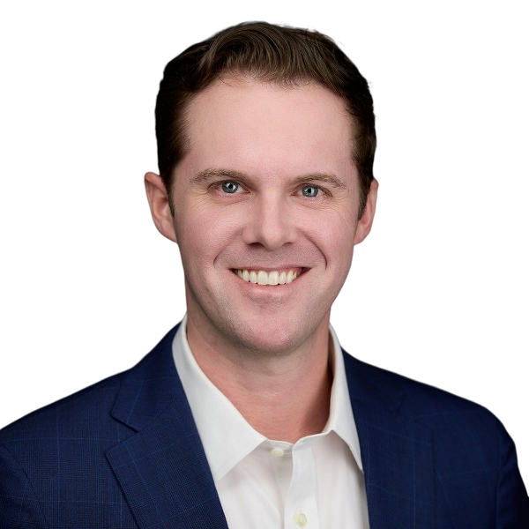
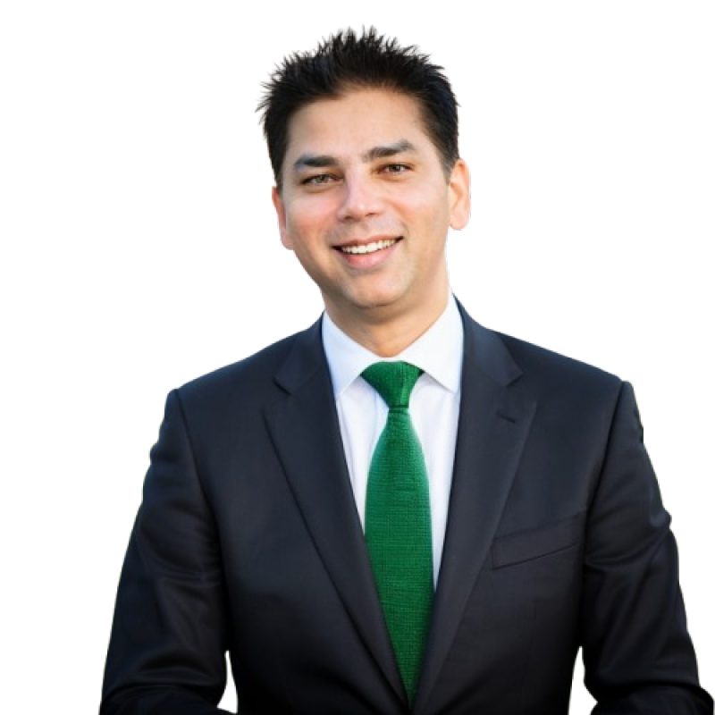
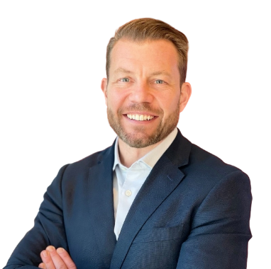
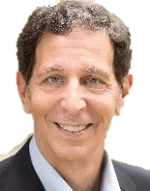
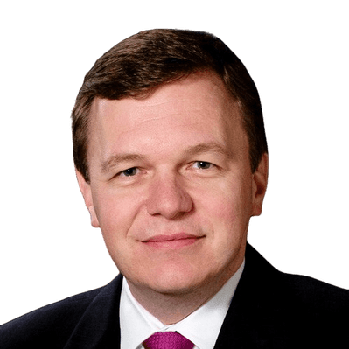




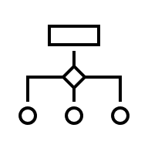








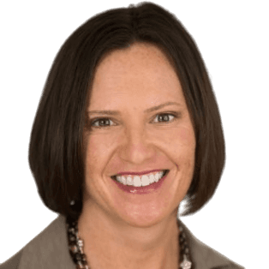
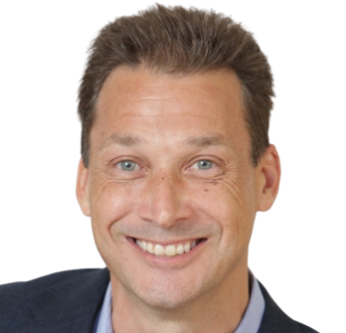



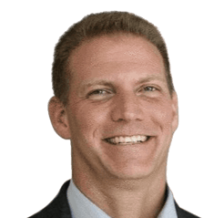

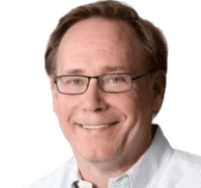
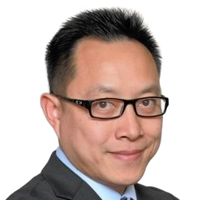
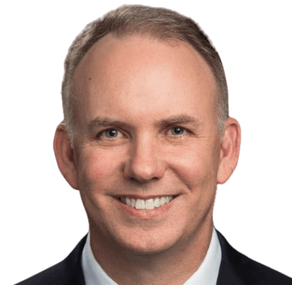

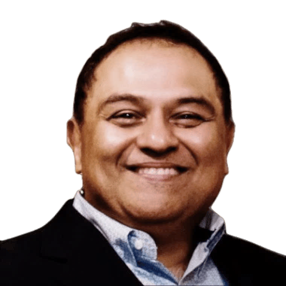
Our model ensures right-fit talent across the integration lifecycle
Enterprise Integration Management Office
Our senior leaders provide strategic oversight while our embedded subject matter experts optimize delivery across all workstreams for measurable value creation
Our Senior Integration project leaders…
…partner with our industry SMEs
Program Management/ Leverage
Change Management & Communications
Program Governance & Interdependency Management
Organizational Design
Customer, Commercial, & GTM
Supply Chain, Manufacturing, & Procurement
Operations & Finance Excellence
Information Technology
HPA teams embed seamlessly with client teams to accelerate integration impact

Slide 7
Our Integration project leaders have extensive ‘in-seat’ experience
 |  | Experience
 |  | Served as IMO and Finance lead across pre-acquisition integration planning and post-close execution; built Day-1/Day-100 plans, TSAs, and synergy models, and led market integration across 17 countries Coordinated the post-acquisition global synergy identification, integration planning, and integration management office for US-based auto parts manufacturer Led the pre-acquisition process and functional integration (3 functions) to support the formation of a top global salt mining and consumables company
 |  | Captured $200M in synergies through operations optimization (fleet & network management) and commercial workstreams (cross-selling and co-selling for 2 airlines) Led $100M cross-border eCommerce supply chain player buyout and integration; post-integration, the asset drove 80% of the vertical’s revenue Captured $25M in synergies across a pharmaceuticals & nutrition business. Sourced 100+ ideas from 20 GMs; prioritized joint GTM, retail partnerships, distribution, sales productivity levers; piloted in 4 countries; instituted value tracking & global rollout playbook
 |  | Designed future organizational structure, created the Day-1 readiness plan (critical to close items, communications, transition plan) and established/executed the 100-Day implementation plan for 2 PE-backed organizations as they underwent a merger Led IMO for industry-consolidating merger of equals, including management of 3rd party resources, functional teams, and executive reporting to facilitate post-close activities Managed post-merger integration activities for supply chain, distribution, finance, sales, and customer service for the combination of two B2C businesses
Chris Bauer
Former Alvaraz & Marsal Manager with deep experience in M&A, integration, cost savings, synergy identification and execution, performance improvement, transformation, and restructuring for private equity portfolio clients across industries. Held an additional role as Lead M&A Analyst at Colorado National Bancorp, where he focused on acquisitions and due diligence.
Anang Singh
Former McKinsey Engagement Manager and Kearney Senior Manager who brings M&A strategy and integration experience spanning pre-close planning, post-merger integration (PMI), transformation, strategic planning & execution, and digital innovation (GenAI/ML). Most recently, served as Director of Strategy, Strategic Planning, & Execution and Chief of Staff for Abbott’s Nutrition business.
Chris Huss
Integration and transformation SME who has decades of experience in operations and transactions spanning consulting and PE. Held numerous consulting roles at Alvarez & Marsal and EY in their M&A and Performance Improvement Practices. Most recently, held senior roles in PE at Platinum Equity and Waud Capital, guiding complex transactions, stand-ups, and merger integrations.

Slide 8
Recently completed integration engagements span various industries and functions
IMO PLANNING
PMI EXECUTION
Client Need | Engagement Outcome
Global CPG company had completed a growth acquisition of a technology product firm and needed support developing and implementing an integration management structure to drive internal decision-making | Integration Framework & Governance: Designed integration framework to hit revenue targets, ensure holiday-season production, stabilize operations, and establish roles, accountability, and fact-based decision-making Transition & Execution: Addressed key priorities and transitioned integration process to internal client stakeholders
Two industry-leading financial service companies merged and required support to establish and manage an Integration Management Office (IMO) without business disruption | Integration Leadership: Established IMO and led integration, merging branch networks and consolidating back-office operations across countries while maintaining business continuity Synergy Realization: Delivered ~80% of first-year synergies in 100 days and doubled projections by year-end, under budget Cultural & Operational Alignment: Managed cultural integration and stakeholder alignment, improving operational efficiency, systems, corporate culture, and strategic positioning
Industry-leading gaming technology provider merged with a complementary player of equal size and needed assistance integrating operations between the two organizations | Integration Planning & Execution: Drove pre-close planning and supported integration in major functional areas throughout the company in two stages Synergy Identification and Planning: Identified synergies and developed integration plans across IT, supply chain, product teams, and other functions Leadership & Governance: Worked directly with the CFO to prepare for management meetings, led staff integration efforts, and track synergies corporate-wide
Leading industrial equipment manufacturer had recently undertaken a complicated international acquisition (the largest the company had ever undertaken) and needed a resource to lead integration planning and execution | PMI Design: Built comprehensive PMI playbook and roadmap outlining timing, expected results, savings, and roles/responsibilities to guide the team through the full integration effort Early Implementation: Served as integration lead, spearheading initial execution against the playbook and ensuring momentum across early workstreams Leadership Enablement & Transition: Identified and trained internal leaders, established tracking mechanisms, and seamlessly transitioned ownership back to client executive
IMO Structure Development
Client: Mattel
Consultants: Michael Bouhadana
Timeline: 2/9/2016 - 4/15/2016
Client: MTAI
Consultants: Ricardo Berner, Michael Bouhadana
Timeline: 6/27/22 - 3/31/23
Client: Light & Wonder (formerly Scientific Games)
Consultants: Bob Kaplan, Gui Karyo, David Byer, Nats Vaidyanathan, Mike Su, George Peng, Dino Mauricio
Timeline: 08/2013 – 04/2014
Client: Husky Injection Molding
Consultants: Luiz Zorzella
Timeline: 12/9/2013 – 03/31/2014
IMO/PMO Establishment and Synergies
PMI Operational/ Functional Efficiency
Integration Planning & Execution

Slide 9
IMO: Initial questions to align strategy, governance, and communication
IMO PLANNING
NON-EXHAUSTIVE
Areas | Pre-close questions to answer now
Guiding Principles | What is the investment thesis and the key sources of value? What does success look like, and what decisions have been made about the end state/blueprint? What guiding principles will govern how we treat people during integration?
Governance & Structure | How/who will make integration decisions? What is the integration governance structure (escalation path, cadence)? What workstreams and cross-functional dependencies need to be defined and sequenced?
Synergies & Risks | What synergies have been identified, how rigorous is the analysis, and where are the gaps? Which initiatives are planned to capture these synergies (workplans, objectives, dates, milestones, resources), and what changes/decisions are required? What are the major risks (commercial, regulatory, operational), and how will we mitigate them?
Integration Plan & Readiness | What does the 100-day plan include, and what are the must-haves prior to close? What is the expected timing/sequence of initiatives, and what are the key interdependencies and constraints? What teams do we need, what resource constraints could limit progress, and what is required to retain key customer/business relationships and talent?
Day-1 / Week-1 Stabilization | What Day-1 readiness activities must be completed before close? What is the scope and plan for Day-1/Week-1 stabilization? Who are the owners and team required to execute stabilization?
Communications, Tracking, & Back Office | What Day-1 continuity activities must be in place across each function (e.g., payroll, system access, compliance approvals, contract obligations)? What critical risks, dependencies, or regulatory requirements exist before close, and how are they being mitigated? What baseline data, system inventories, and contract/people information must be gathered to enable Day-1 readiness and integration planning?

Slide 10
IMO: Pre-close planning & Day-1 readiness playbook
IMO PLANNING
NON-EXHAUSTIVE
 | Areas | Details
 | Strategic Planning | Define vision/objectives: Set out the integration’s strategic intent (e.g., end-to-end observability, stronger customer growth) with measurable KPIs Stand up an integration team: Form an Integration Management Office with clear decision rights and leadership from both companies Develop an integration roadmap: Phase work into Day-1, 30/100-day, and 12-month milestones with clear accountability
 | Cultural Integration | Conduct a cultural assessment: Understand similarities and differences in values and ways of working between two companies Align leadership behaviors: Ensure executives model collaboration and reinforce the integration story
 | Human Resources | Retention plan for critical talent: Protect expertise/critical talent through targeted retention and career pathing Plan workforce needs: Identify overlaps and fill skill gaps
 | IT & Technology | Plan Day-1 readiness: Guarantee secure access to email, systems, and data on close Establish frameworks & priorities: Unified cybersecurity controls and audit points
 | Finance & Legal | Map out financial systems: Plan billing, accounting, and reporting processes Develop tax and treasury strategy: Optimize cash management, capital structure, and global tax planning
 | Operations & Customer | Design standardized processes: Create “to-be” core workflows in sales, procurement, and customer service Review supply chain & facilities: Outline supply-chain optimization and facilities review Design customer onboarding: Build combined customer-onboarding playbooks
 | Communication & Stakeholders | Develop a communications charter: Define purpose, guiding principles, and desired outcomes for integration communications Craft program-level messaging: Establish consistent messages on vision, priorities, and synergy goals for all stakeholders Design media matrix & work plan: Map which audiences (employees, customers, partners) get which messages, through which channels, when Orchestrate pre-close communications: Prepare customer FAQs, employee welcome packs, and joint press/analyst briefings
 | Day-1 & Tracking | Deliver a Day-1 playbook: Cover essentials (system access, payroll, welcome materials, FAQs) and ensure immediate customer reassurance Set KPIs and dashboards: Track cross-sell attach rates, customer retention, and time-to-resolution metrics

Slide 11

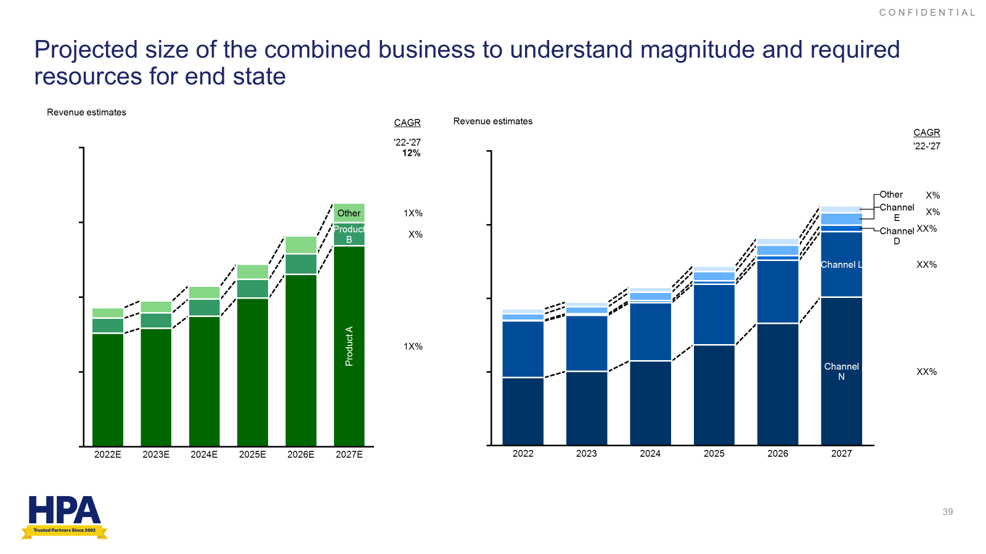
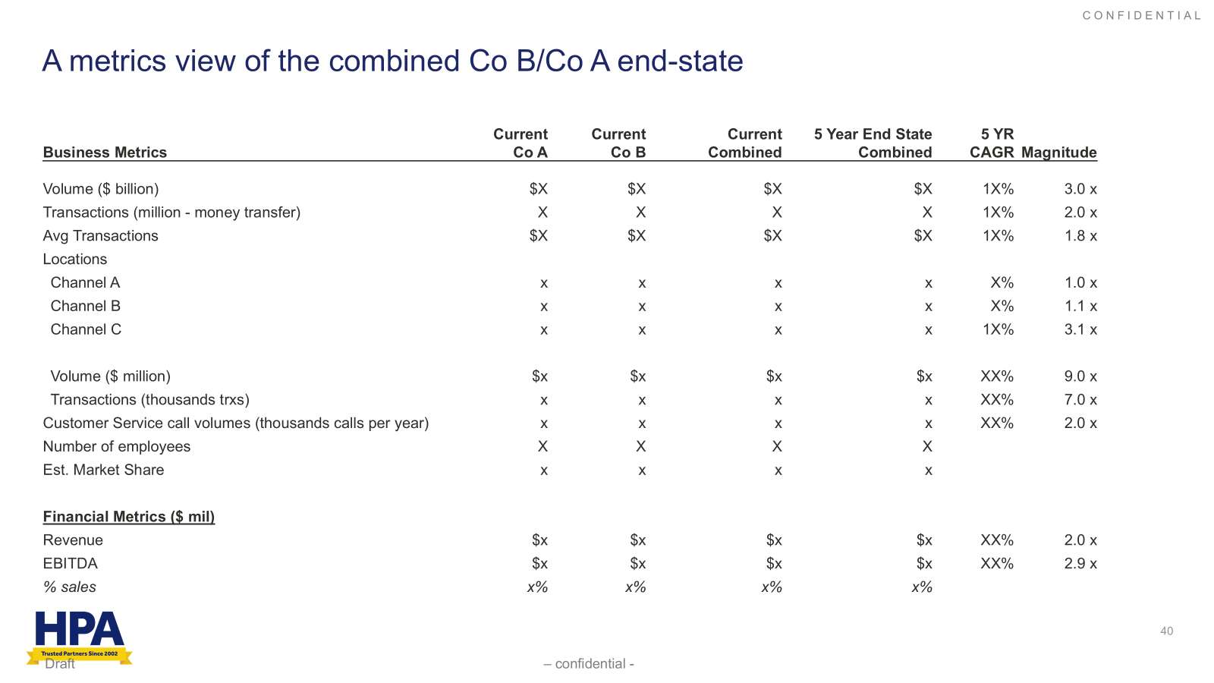
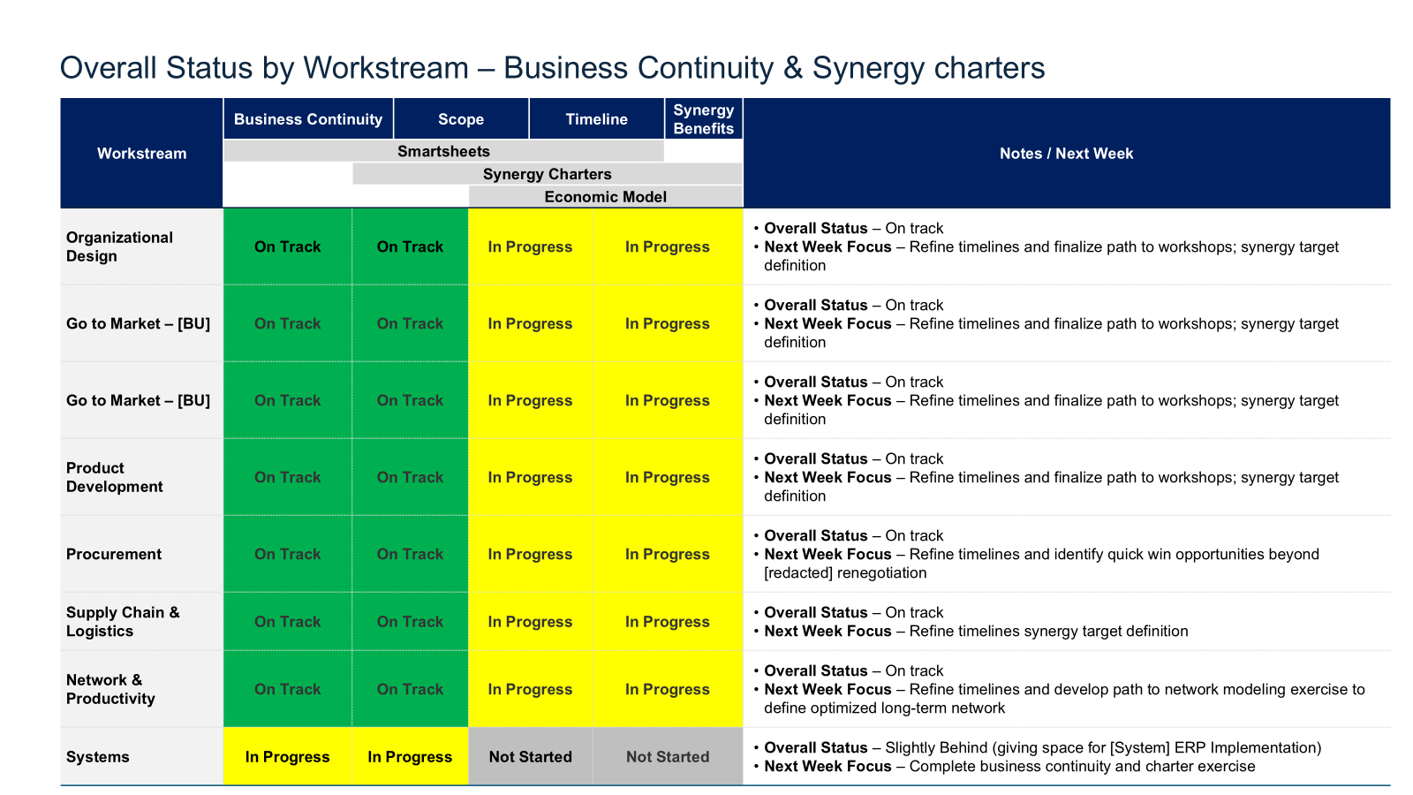
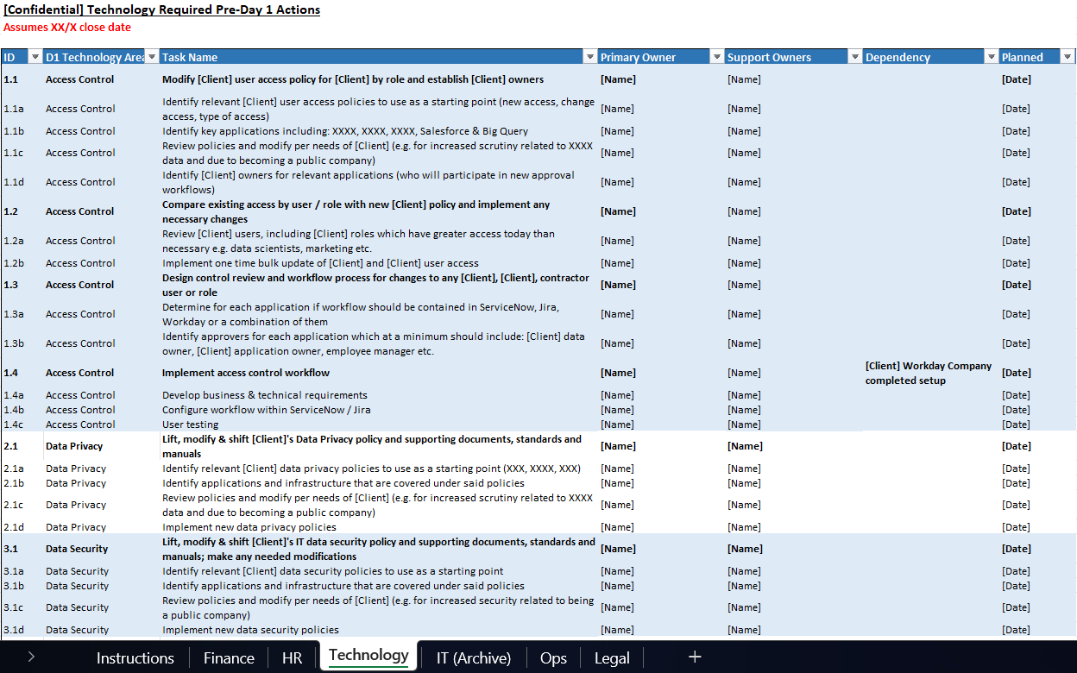
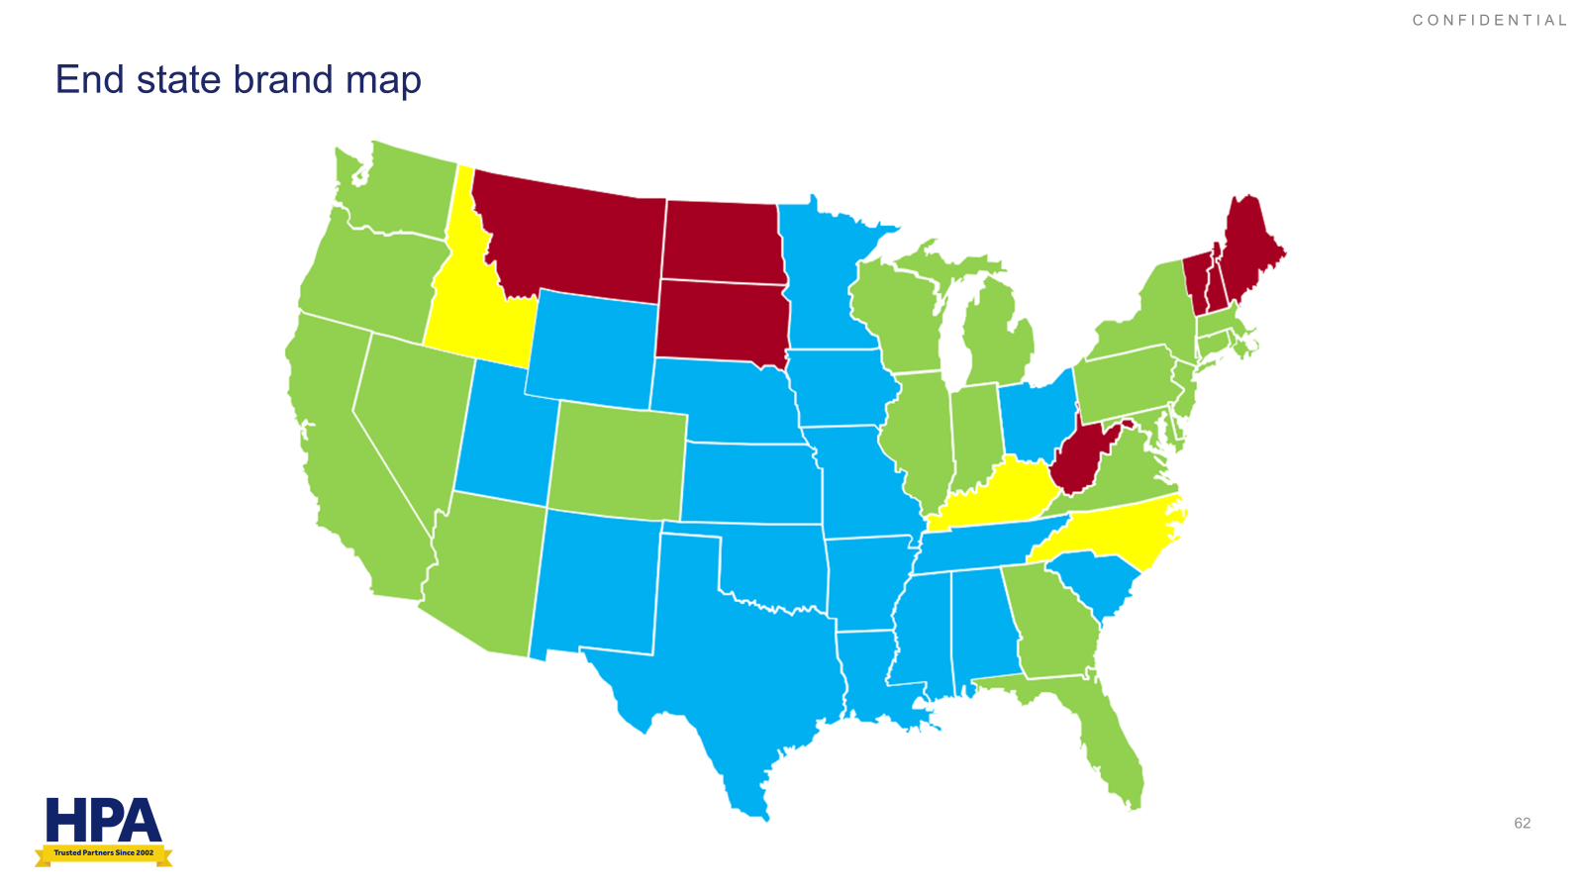
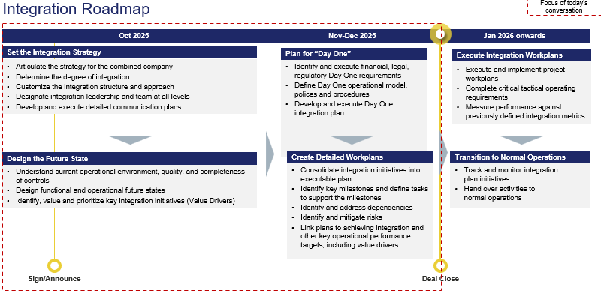
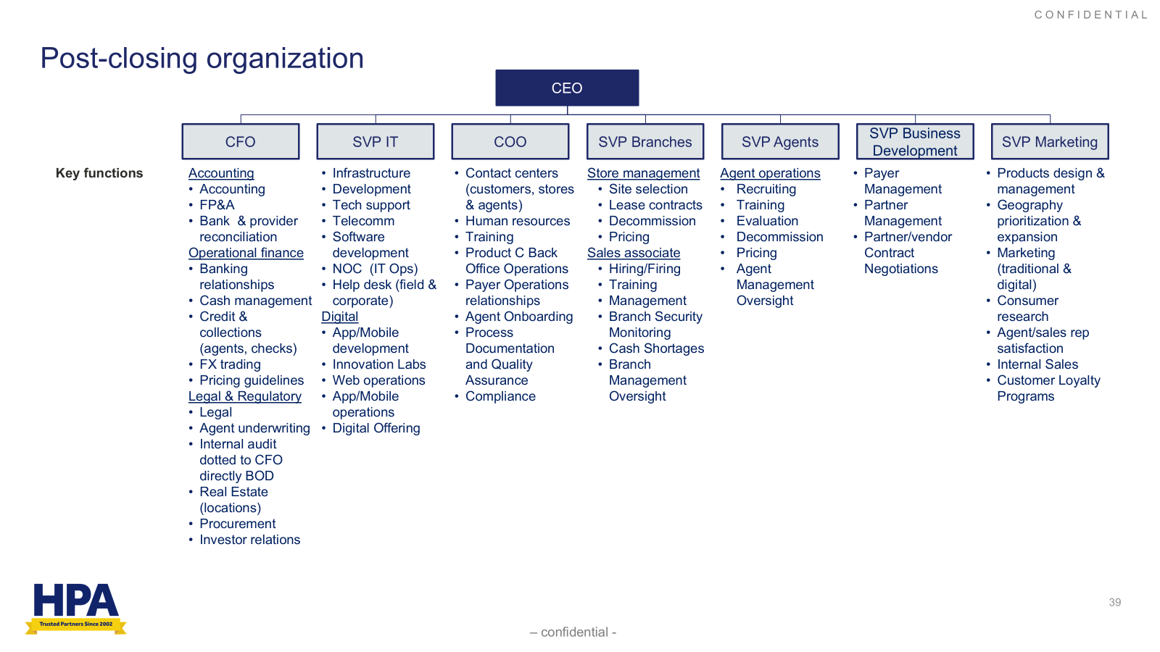
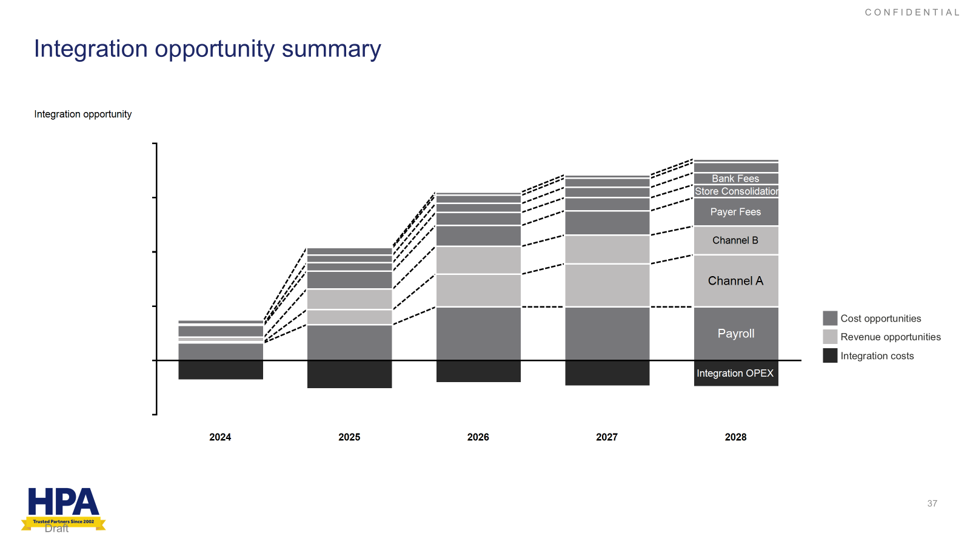
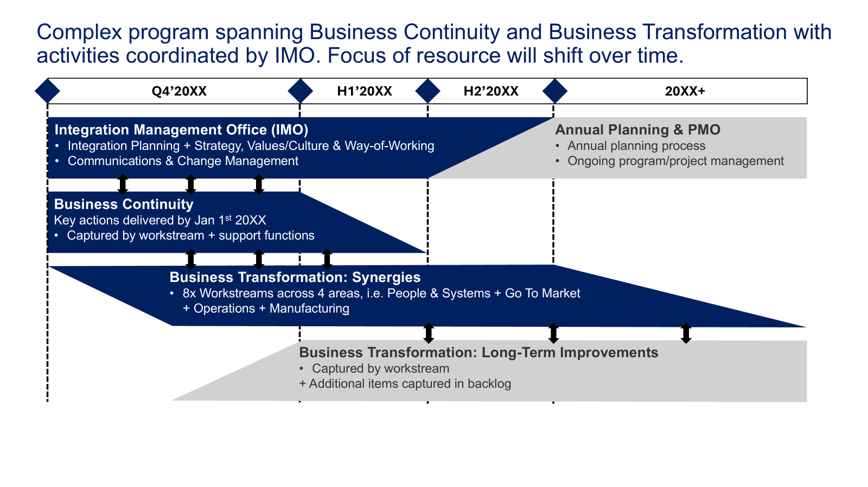
IMO: Deliverable examples
IMO PLANNING
NON-EXHAUSTIVE
Objective: Develop a clear view of the point of arrival and a path to get there
Key Deliverables
End State Blueprint & Integration Economics
Integration Planning
End state blueprint
Developed detailed five-year business forecast, incorporating revenue projections, cost drivers, and market assumptions
Integration economics
Evaluated targeted cost and revenue synergies across functions (e.g., SG&A, operations, procurement)
Built achievement timeline for synergy realization, including interim milestones and dependency mapping
Integration workstreams
Established dedicated workstreams for major functional areas (e.g., finance, HR, IT, operations) with clear owners
Clarified workstream charters, defining scope, deliverables, and success metrics for each group

Slide 12
PMI: Key questions to drive post-close execution and value
PMI EXECUTION
NON-EXHAUSTIVE
Areas | Post-close questions to answer now
Operations | How is the IMO operationalized (kickoff, resourcing, charters for workstreams)? How are Day-1 activities executed, validated, and signed off? How are post-Day-1 priorities sequenced (quick wins vs. long-term initiatives)? How is sponsor engagement structured for oversight and decision-making?
Communication | How are integration updates cascaded to employees (cadence, format)? How is customer reassurance and retention messaging executed? How are sensitive changes (org design, systems, roles) communicated effectively?
Tracking | How is progress against plan and milestones tracked across workstreams? How are synergies validated and reported vs. deal model assumptions? What is the cadence and format for reporting to leadership and sponsor? How are risks/issues logged, prioritized, and escalated consistently?
Back Office | How will policies, systems, and processes be harmonized across functions (e.g., HR policies, IT platforms, finance reporting, compliance frameworks, legal templates)? What is the roadmap for longer-term integration and optimization (system migrations, org design, treasury centralization, entity rationalization)? How will ongoing monitoring and governance be structured to track risks, compliance, and value realization across back-office functions?

Slide 13
PMI: Post-close execution & synergy capture playbook
PMI EXECUTION
NON-EXHAUSTIVE
 | Areas | Details
 | Day-1 Execution | Execute the Day-1 playbook: access to systems/email, payroll, welcome materials/FAQs, customer reassurance.
 | Human Resources | Unify HR policies and systems: Bring payroll, benefits, and HR platforms into a consistent model Retain and upskill talent: Execute retention actions and career paths; launch cross-training to strengthen combined capabilities
 | IT & Security | Integrate core IT platforms: Consolidate CRM, collaboration, and service management systems. Operationalize cybersecurity controls: Apply unified controls and establish ongoing audits to monitor vulnerabilities
 | Finance & Legal | Integrate financial systems: Align billing, accounting, and reporting processes Implement tax and treasury strategy: Optimize cash management, capital structure, and global tax; update contracts/compliance
 | Operations & Customer | Standardize core operations: Align sales, procurement, and customer service processes across the enterprise Optimize supply chain and facilities: Consolidate vendors/contracts and execute facility changes where efficiency gains exist
 | Commercial Integration & Execution | Unify commercial model: Align segments, coverage, and territories; harmonize pricing and packaging Launch growth plays: Execute priority cross-sell initiatives; integrate CRM/pipeline governance with shared KPIs
 | Measurement & Adaptation | Stand up dashboards and cadence: Track attach, retention, and time-to-resolution with a clear reporting rhythm Reinforce the synergy story: Communicate progress and adapt plans based on risk signals and employee/customer feedback

Slide 14
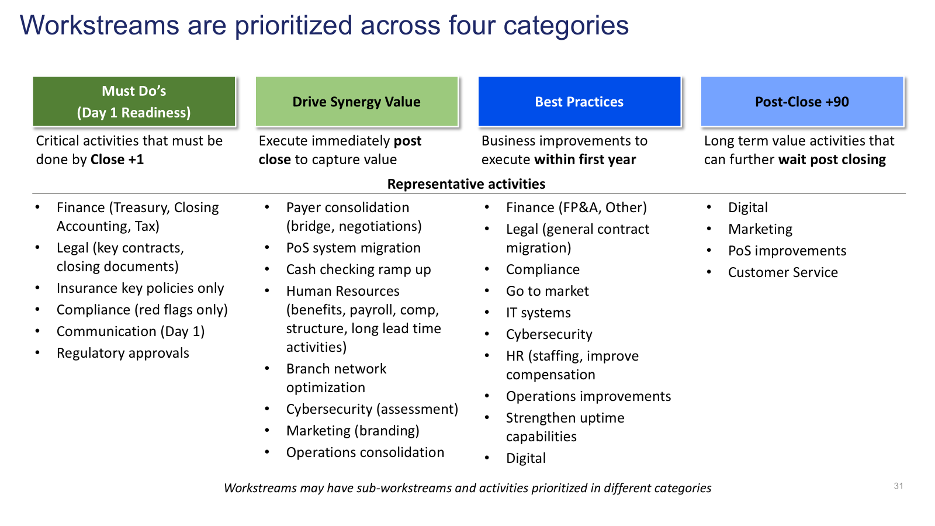
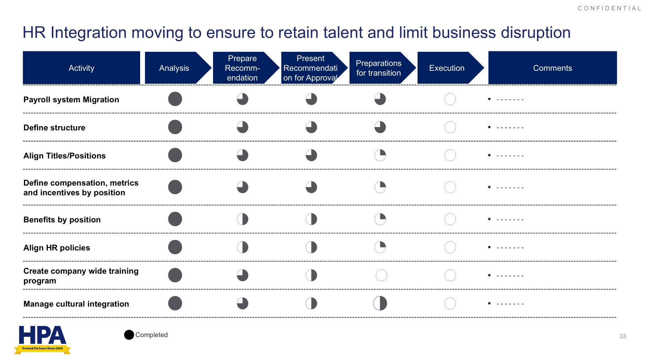
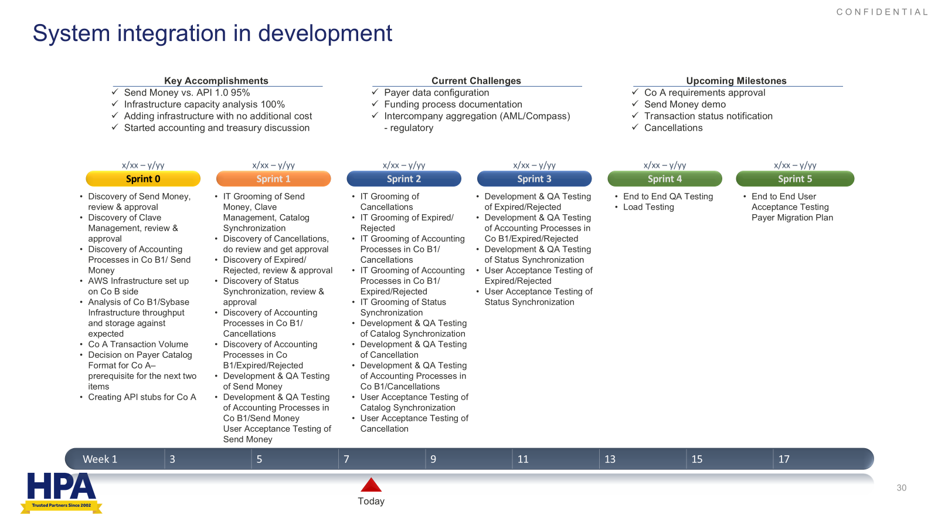
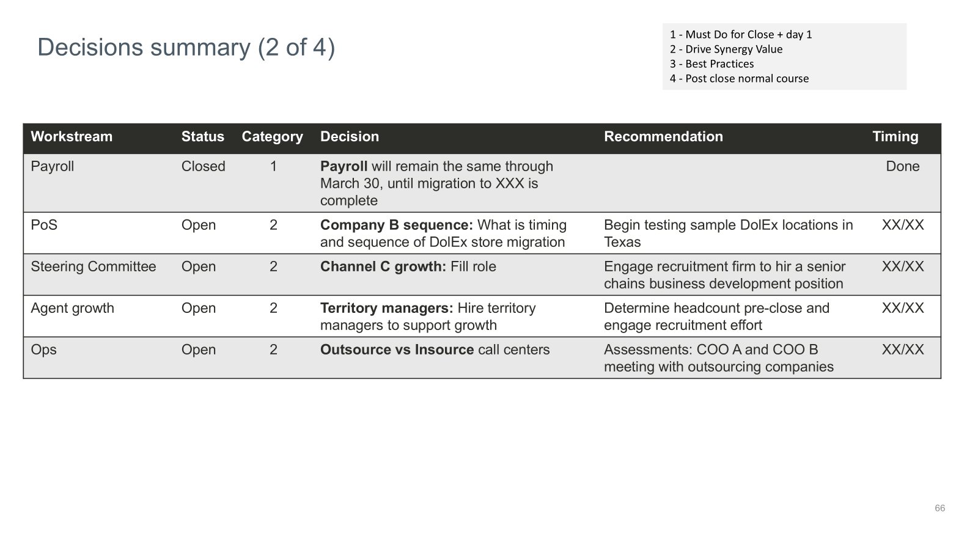
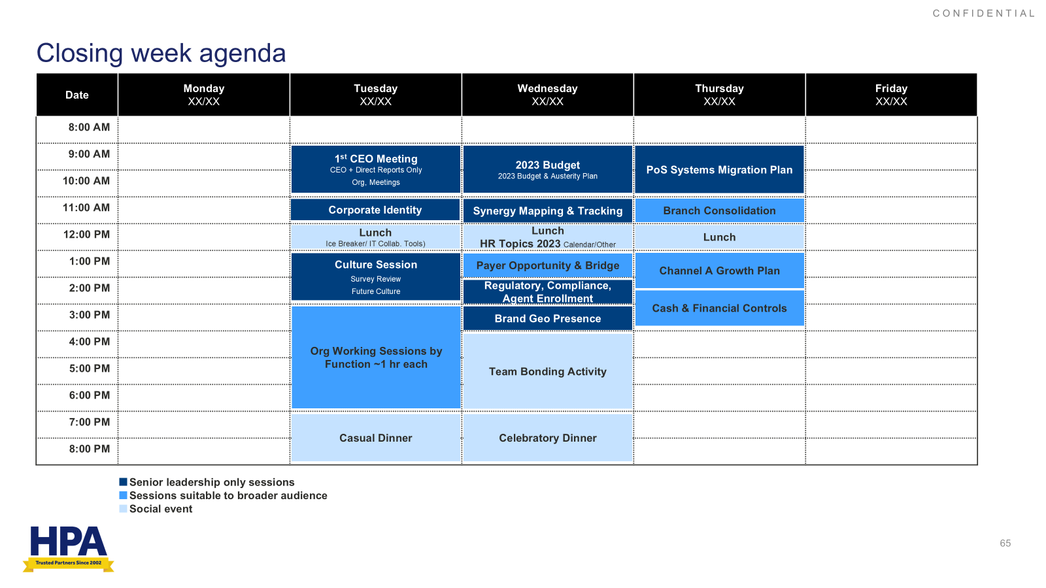
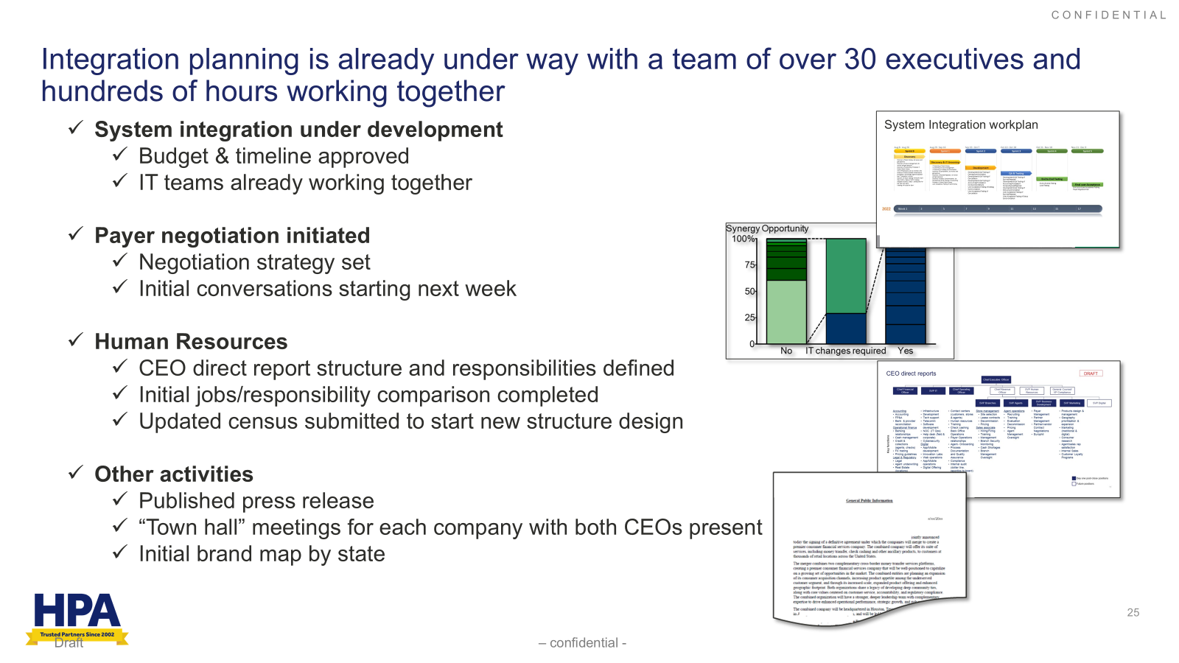
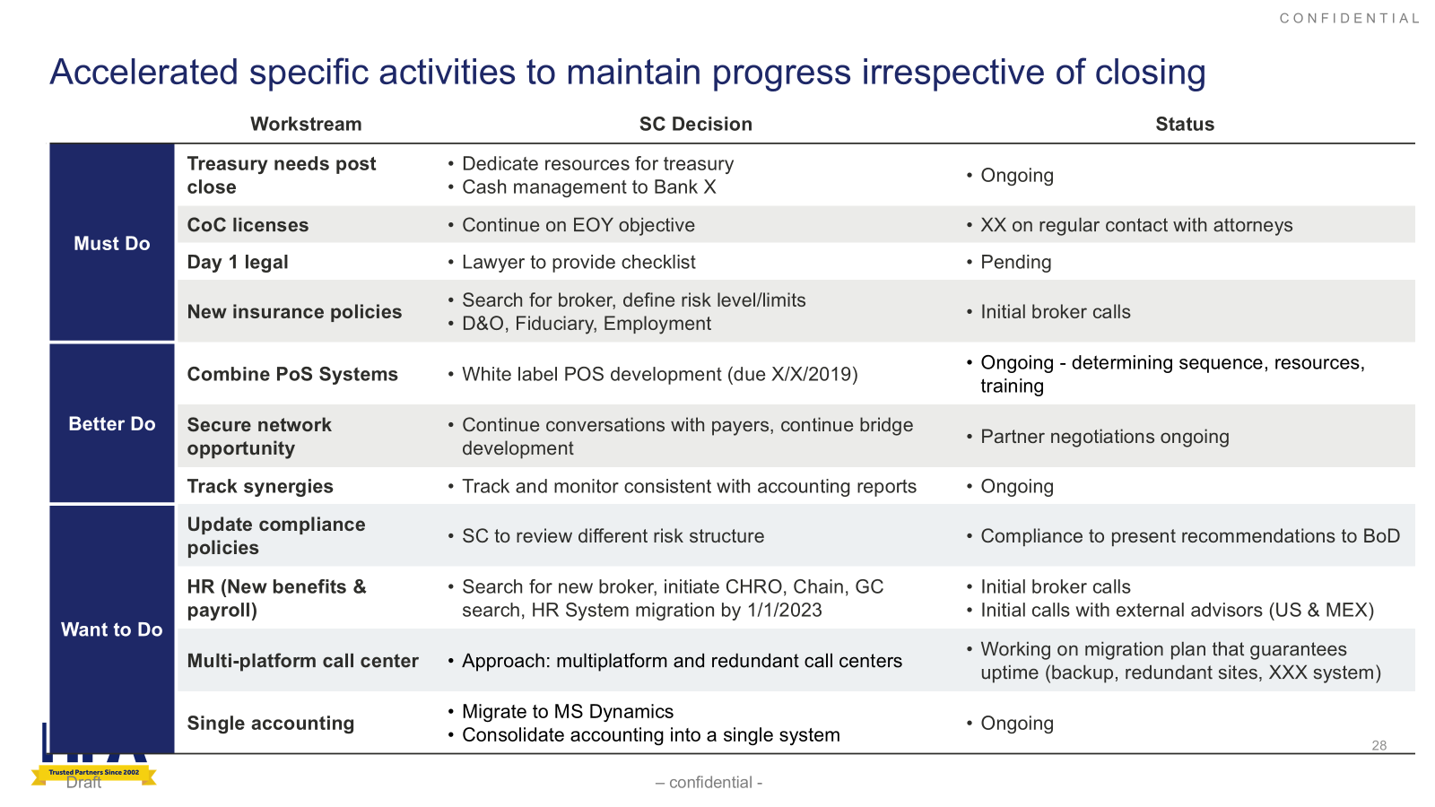
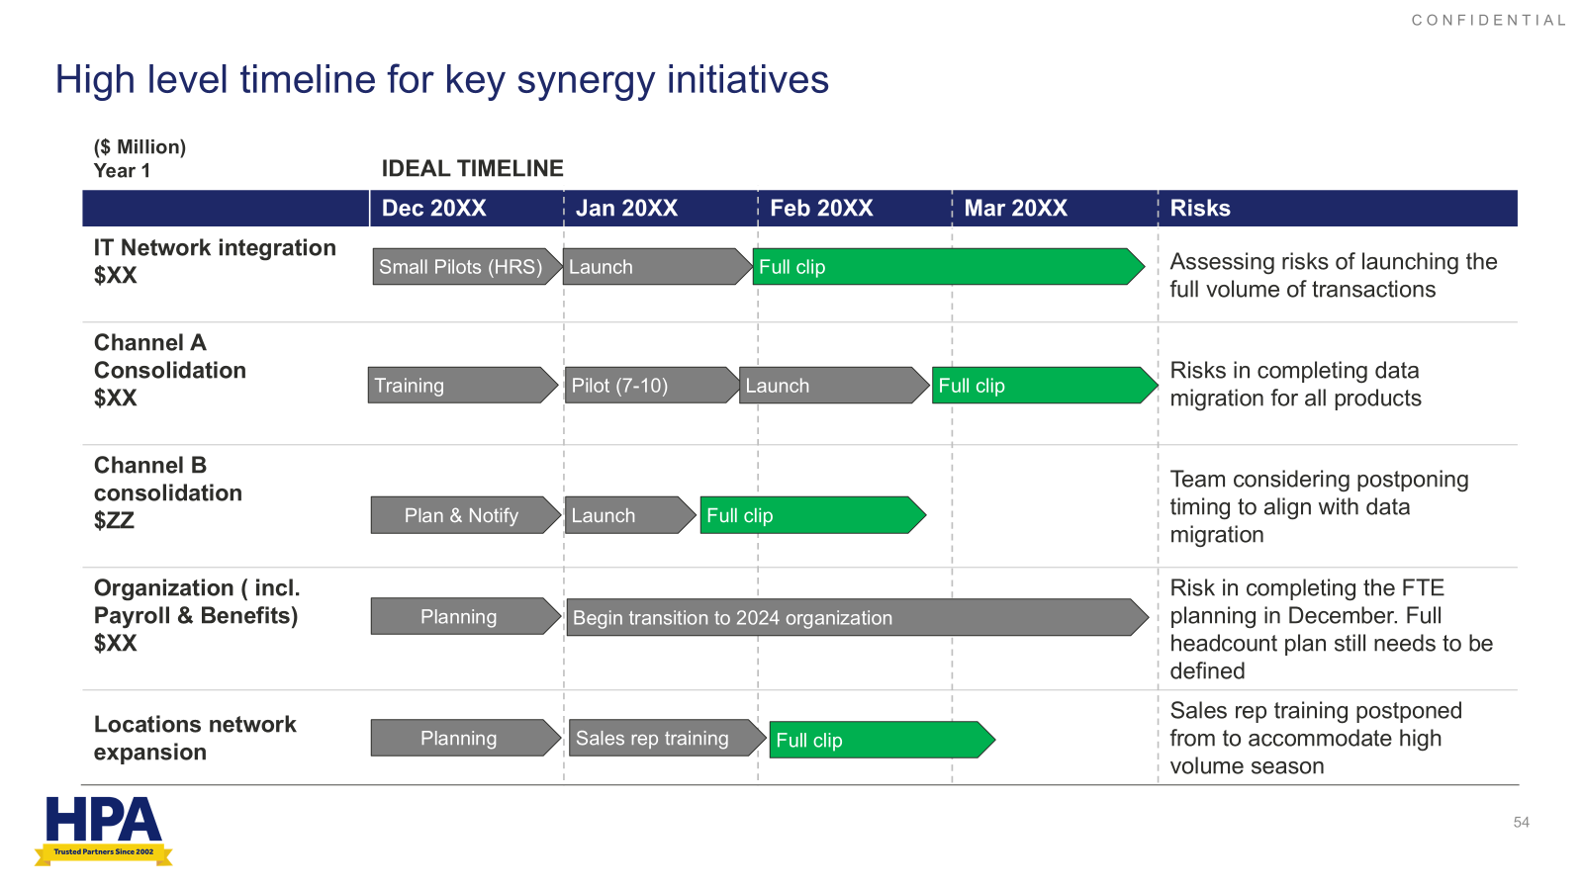
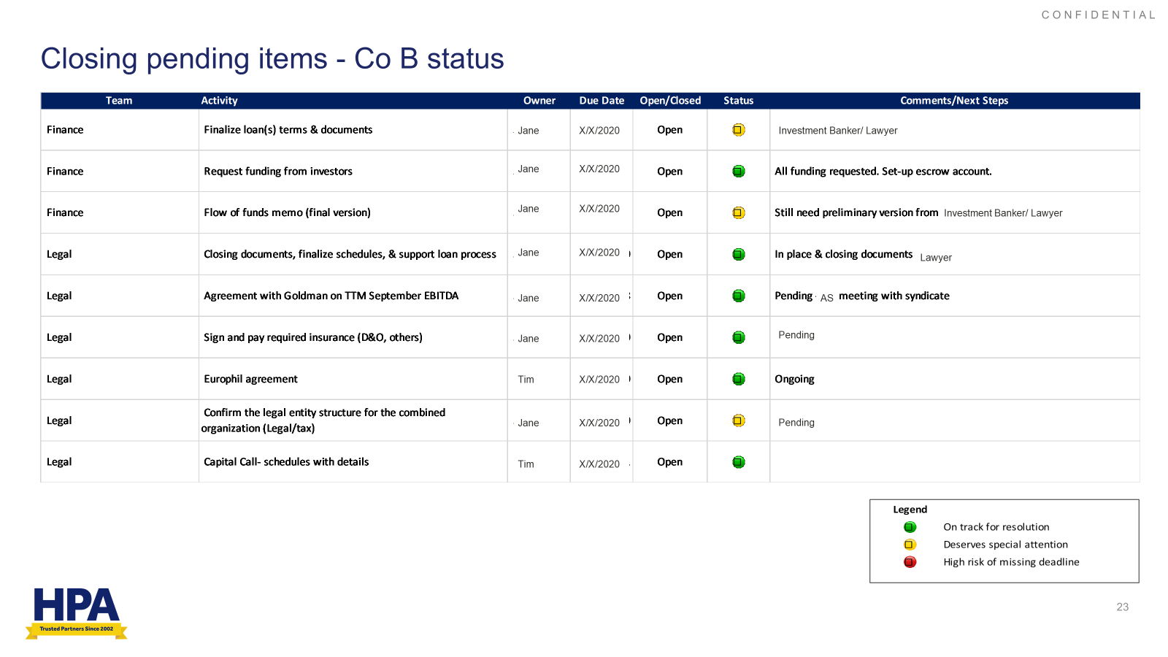
PMI: Deliverable examples
PMI EXECUTION
NON-EXHAUSTIVE
Objective: Drive integration execution and impact from Day 1
Key Deliverables
Workstreams & Coordinated Integration
Workstream launch
Kickstarted cross-functional working teams aligned to integration priorities
Coordinated integration
Facilitated joint planning workshops to align merged teams on objectives, roles, and systems
Best practices & quick wins
Implemented leading practices from both legacy organizations to optimize efficiency
Identified and fast-tracked synergy opportunities for immediate impact
Managed progress
Identified potential roadblocks early via issue tracking and escalation protocols
Tracked synergies and integration metrics, reporting results to leadership
Best Practices/Quick Wins
Progress Tracking

